Slide 1
MODERN OPERATING SYSTEMS
Chapter 1
Introduction
Tanenbaum, Modern Operating Systems 3 e, (c) 2008 Prentice-Hall, Inc. All rights reserved. 0-13-6006639

Slide 2
What Is An Operating System?
Lots of hardware !!
One or more processors
Main memory
Disks
Printers
Various input/output devices
Managing all these components requires a layer of software – the operating system
Tanenbaum, Modern Operating Systems 3 e, (c) 2008 Prentice-Hall, Inc. All rights reserved. 0-13-6006639

Slide 3
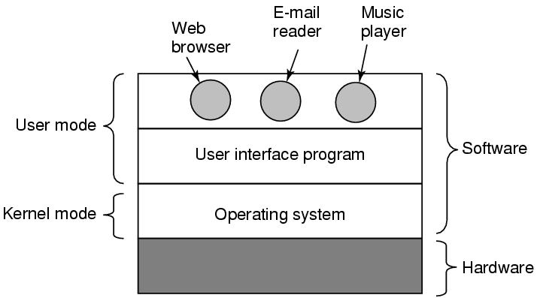
Where is the software?
Where the operating system fits in.
Tanenbaum, Modern Operating Systems 3 e, (c) 2008 Prentice-Hall, Inc. All rights reserved. 0-13-6006639

Slide 4
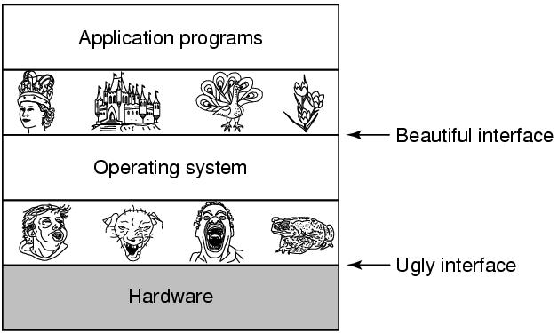
The Operating System as an Extended Machine
Tanenbaum, Modern Operating Systems 3 e, (c) 2008 Prentice-Hall, Inc. All rights reserved. 0-13-6006639

Slide 5
The Operating System as a Resource Manager
Allow multiple programs to run at the same time
Manage and protect memory, I/O devices, and other resources
Multiplexes (shares) resources in two different ways:
  In time
  In space
Tanenbaum, Modern Operating Systems 3 e, (c) 2008 Prentice-Hall, Inc. All rights reserved. 0-13-6006639

Slide 6
History of Operating Systems
Generations:
(1945–55) Vacuum Tubes
(1955–65) Transistors and Batch Systems
(1965–1980) ICs and Multiprogramming
(1980–Present) Personal Computers, Tablets, Phones
Tanenbaum, Modern Operating Systems 3 e, (c) 2008 Prentice-Hall, Inc. All rights reserved. 0-13-6006639

Slide 7

Transistors and Batch Systems (1)
Figure 1-3. An early batch system.
(a) Programmers bring cards to 1401.
(b)1401 reads batch of jobs onto tape.
Tanenbaum, Modern Operating Systems 3 e, (c) 2008 Prentice-Hall, Inc. All rights reserved. 0-13-6006639

Slide 8
More third generation
Time Sharing (CTSS)
Multics
Unix
Linux
.
Tanenbaum, Modern Operating Systems 3 e, (c) 2008 Prentice-Hall, Inc. All rights reserved. 0-13-6006639
Notes:
MULTICS
Timesharing CTSS (MIT)
Multics
UNix

Slide 9
Fourth generation
PCs
Network Operating Systems
Distributed Operating Systems
.
Tanenbaum, Modern Operating Systems 3 e, (c) 2008 Prentice-Hall, Inc. All rights reserved. 0-13-6006639
Notes:
MULTICS
Timesharing CTSS (MIT)
Multics
UNix

Slide 10
The Operating System Zoo
PC operating systems-Linux, Mac, Windows
Smart phone operating systems- Android, iPhone, Blackberry
  No hard disk
  Palm, Symbian popular OS’s
Tanenbaum, Modern Operating Systems 3 e, (c) 2008 Prentice-Hall, Inc. All rights reserved. 0-13-6006639

Slide 11
The Operating System Zoo
Embedded operating systems-TV sets, cars, DVDs, MP3s
  Everything is in ROM (no apps can run on it)
  QNx, Vxworks
Real time operating systems
  Hard (eg. factory) deadline
  Soft (eg. multi-media) deadline
  Smart card OS (eg border crossing cards)
    Java in ROM
Tanenbaum, Modern Operating Systems 3 e, (c) 2008 Prentice-Hall, Inc. All rights reserved. 0-13-6006639

Slide 12


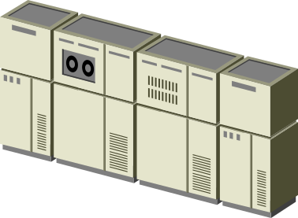


Abstract Machines
Abstract
Machines
Idea
Program
Result
Physical
Machine
Idea
Program
Result
…
…
…
Idea
Program
Result
Operating Systems: A Modern Perspective, Chapter 1

Slide 13
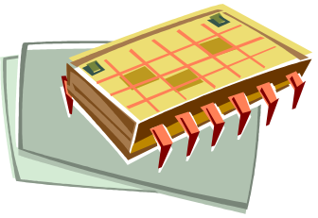






The OS as a Conductor
The OS coordinates the sharing and use of all the components in the computer
Operating Systems: A Modern Perspective, Chapter 1

Slide 14
Multiprogramming
Abstract
Machine P_{i}
Abstract
Machine P_{j}
Abstract
Machine P_{k}
…
OS Resource Sharing
P_{i} Memory
P_{k} Memory
…
Time-multiplexed
Physical Processor
P_{j} Memory
Space-multiplexed
Physical Memory
Operating Systems: A Modern Perspective, Chapter 1

Slide 15
Algorithms, Programs, and Processes
Idea
Execution Engine
Files
Files
Algorithm
Files
Status
Stack
Source
Program
Binary
Program
Data
Other
Resources
Process
Operating Systems: A Modern Perspective, Chapter 2

Slide 16
Algorithms, Programs, and Processes
Idea
Execution Engine
Files
Files
Algorithm
Files
Status
Stack
Source
Program
Binary
Program
Data
Other
Resources
Process
Operating Systems: A Modern Perspective, Chapter 2

Slide 17
Operating System Concepts
Processes
Address spaces
Files
Input/Output
Protection
The shell
Tanenbaum, Modern Operating Systems 3 e, (c) 2008 Prentice-Hall, Inc. All rights reserved. 0-13-6006639

Slide 18
Processes
Program in execution
Lives in address space
Process table
  Keeps info about process
  Used to re-start process
Shell (command interpreter) reads commands from terminal
Tanenbaum, Modern Operating Systems 3 e, (c) 2008 Prentice-Hall, Inc. All rights reserved. 0-13-6006639

Slide 19

A Process Tree
Process creates child processes
Tree structure
Tanenbaum, Modern Operating Systems 3 e, (c) 2008 Prentice-Hall, Inc. All rights reserved. 0-13-6006639

Slide 20
Process
Can communicate with one another
Have UID’s and group ID’s (GID)
Can communicate with one another (IPC)
Tanenbaum, Modern Operating Systems 3 e, (c) 2008 Prentice-Hall, Inc. All rights reserved. 0-13-6006639

Slide 21
Special files
Special files-can use same calls for I/O as for files. OS treats them as files.
  Block special files (disks)
  Character special files (line printers, modems)
  Kept in /dev directory, e.g. /dev/lp is line printer
Tanenbaum, Modern Operating Systems 3 e, (c) 2008 Prentice-Hall, Inc. All rights reserved. 0-13-6006639

